Slide 1
Secure Data Hiding In Images Using Steganography
CAPSTONE PROJECT
Presented By: Aditya Rana
Student Name : Aditya Rana
College Name & Department : Birla Institute of Applied Sciences, Bhimtal
(Computer Science and Engineering)

Slide 2
OUTLINE
Problem Statement
Technology used
Wow factor
End users
Result
Conclusion
Git-hub Link
Future scope

Slide 3
Problem Statement
Secure communication is essential in the digital age.
Steganography allows hiding messages inside images without raising suspicion.
Traditional encryption methods are often detectable.
This project aims to provide a simple and effective way to securely embed and retrieve messages from images.

Slide 4
Technology used
Programming Language: Python
Libraries: OpenCV or CV2 (for image processing), String Module
Concepts: Steganography, Image Processing
Operating System: Windows 10 Home (64-bit)
Minimum System Requirements:
Python Version: 3.0 or above
RAM: Minimum 2GB
Storage: At least 100MB free space

Slide 5
Wow factors
AES Encryption adds an extra layer of security before embedding messages, making the process even more secure.
Uses images as a medium to hide sensitive information.
The image looks the same even after embedding a message.
Passcode protection ensures only authorized users can retrieve the message.
Minimal dependencies make it lightweight and easy to use.

Slide 6
End users
Cybersecurity Professionals – For secure data transmission.
Students & Researchers – For learning and experimentation in cryptography.
Journalists & Whistleblowers – To send confidential information securely.
General Users – Anyone looking for a simple way to hide messages in images

Slide 7
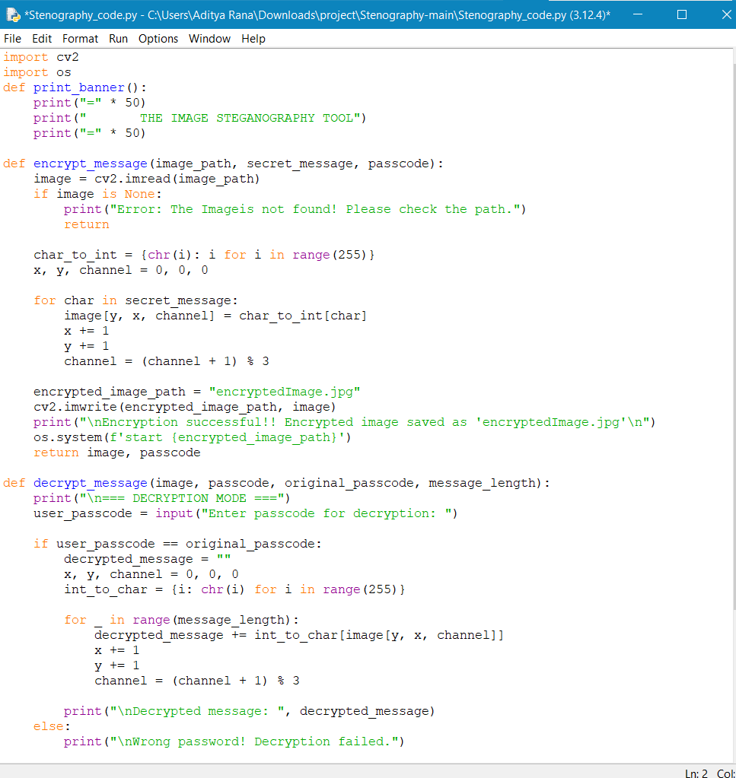
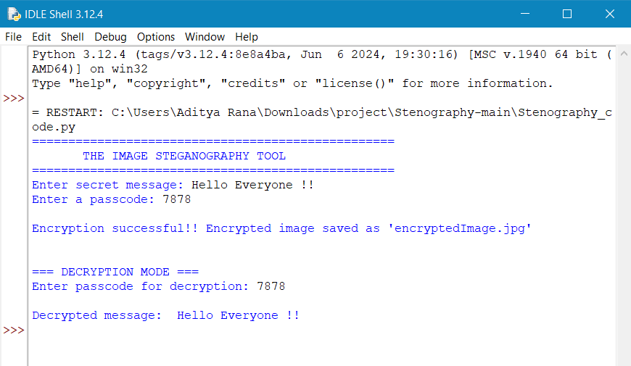
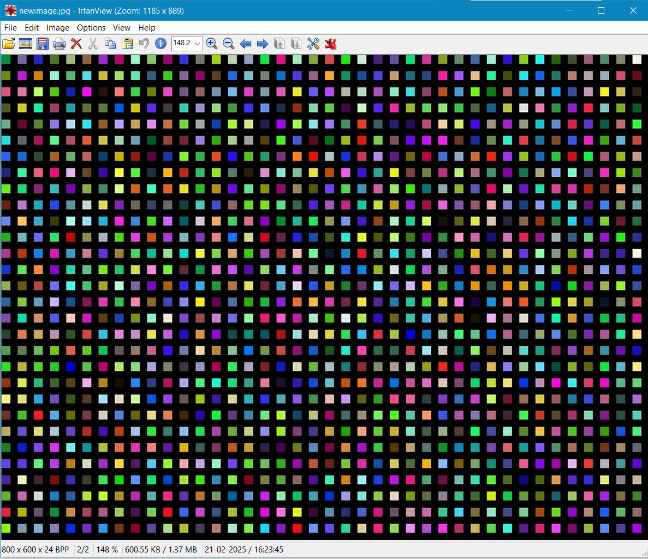
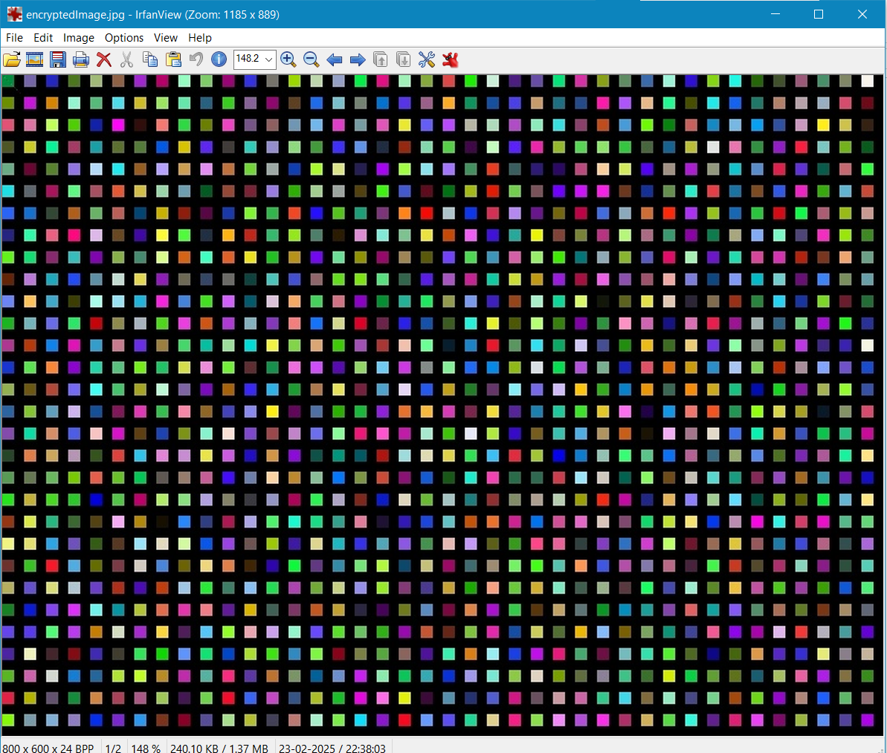
Results
Main Code :
Result /Output:
Input Image file:
Output Image file:

Slide 8
Conclusion
Steganography is a powerful method for secure communication.
Protecting data in everyday communication becomes more accessible with this technique.
This project provides an easy-to-use tool for hiding sensitive data inside images.
Further improvements can enhance security and usability.

Slide 9
GitHub Link
https://github.com/Aditya9700/Stenography_project

Slide 10
Future scope
Support for different file formats (e.g., PNG, BMP).
Advanced encryption algorithms for extra security.
Graphical User Interface (GUI) for better usability.
Mobile App Integration for on-the-go secure communication.
Multi-layer security using multiple encryption techniques.

Slide 11
THANK YOU

